Slide 1

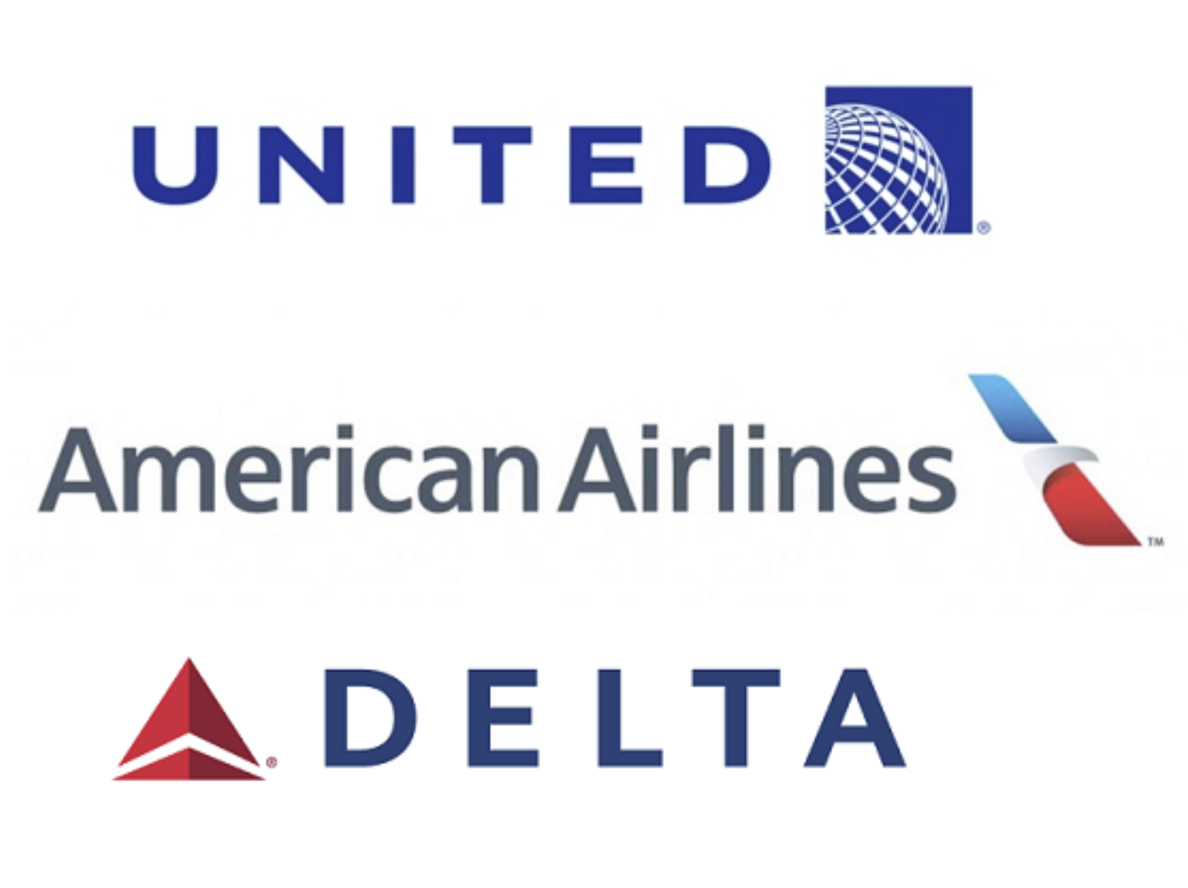
Up in the Air Savings: Maximizing Profitability in the Airline Industry
ANAGHA SHEVADE (ASS210013)
VENKATA SAI AJIT KUMAR GARLAPATI (VXG210083)
TURNER CHRISTOPHER PIKULINSKI (TCP170230)
ARVIND RAJ PALEPU (AXP220005)

Slide 2
Business Case introduction
Our group has decided to analyze 2017-2018 US Domestic Flight data to identify potential correlations and inefficiencies in individual airlines operations.
To do this we will identify average arrival and departure delays, as well as calculate the average cost of individual Airline flights.
We have identified 7 significant questions but are only presenting 4 of them now targeting Airline size, revenue, flight count, delays, time-of-year, and cancelations to optimize airline operations and subsequent cost savings

Slide 3
Business Case Qualification
According to the International Air Transport Association (IATA), the global airline industry generates around $2.7 trillion in annual revenue, and it is expected to grow by 4.1% annually over the next two decades.
In 2021, the industry carried an estimated 2.6 billion passengers and 57.8 million metric tons of cargo, while the total number of scheduled flights worldwide reached 33.2 million.
The Airline industry has a moral responsibility to continue to re-evaluate business practices, increase affordability, and optimize operational structure to facilitate travel and commerce.

Slide 4
Business Question Introduction
Is there a correlation between the percent of yearly flights delayed per Airline and yearly revenue?
Which Airline on average has the most arrival and departure delays, what are the potential solutions, and subsequent cost savings?
Which factor amongst security clearance, carrier delay, weather disturbance, late aircraft and NAS has been responsible for causing the greatest number of departure delays?
Between which Airport had the greatest number of delays and what delay factor contributed the most?

Slide 5
Data qualification
Data was initially collected from the U.S. Department of Transportation's (DOT) Bureau of Transportation Statistics and then posted on Kaggle.com.
The DOT tracks the on-time performance of domestic flights operated by large air carriers.
Summary information on the number of on-time, delayed, canceled, and diverted flights is published in DOT's monthly Air Travel Consumer Report and in this dataset of 2017-2018 flight delays and cancellations.

Slide 6
Data architecture
For this Project, our group has decided to work with Hadoop plus Spark over just Hive for its faster processing, increased scalability, and its flexibility of using multiple programming languages.
Within the Hadoop architecture we are using the Hadoop Distributed File System (HDFS), MapReduce, YARN, Flume, Sqoop, and Spark.

Slide 7
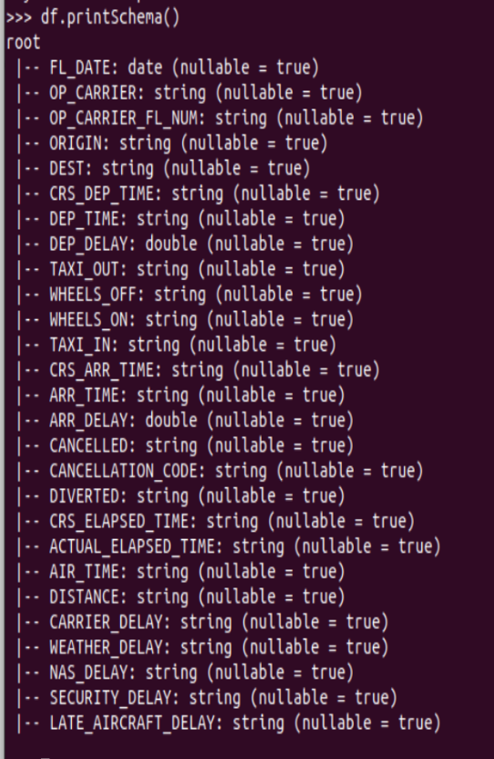
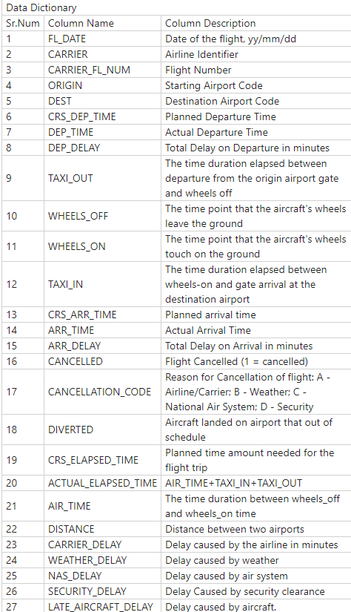
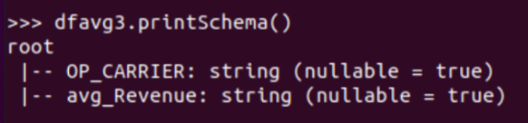
Data structure
2017-2018 Flight Data Frame consists of the 27 Columns listed below.
‘FL_DATE’ identifies the flight date.
‘ARR_DELAY’ and ‘DEP_DELAY’ represent the Arrival and Departure delays.
‘ACTUAL_ELAPSED_TIME’ represents AIR_TIME+TAXI_IN+TAXI_OUT
Yearly Airline Revenue Data Frame consists of two columns
‘OP_CARRIER’ was used to inner join with Flight df for further analysis

Slide 8
Business questions queries and solutions

Slide 9
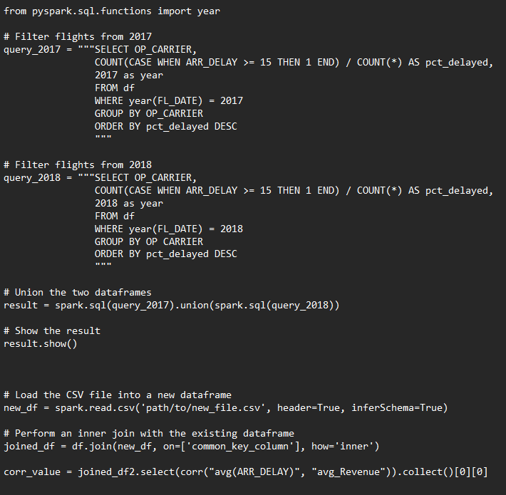
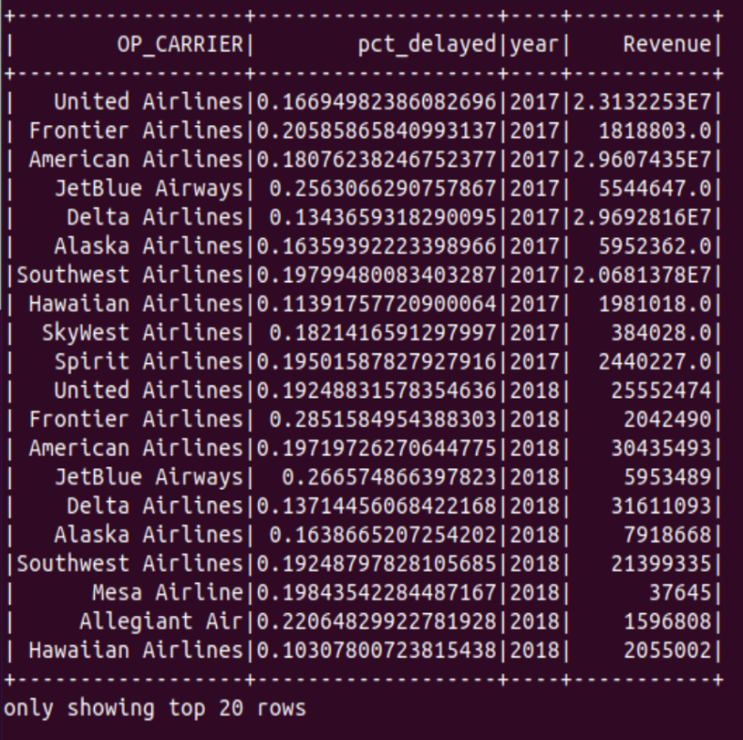
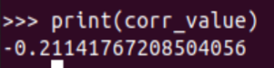
Business Question #1: Is there a correlation between the percent of yearly flights delayed per Airline and yearly revenue?
Table 1: Displays the percent of flights that are delayed at least 15 minutes for each Airline for Years 2017 and 2018 joined with yearly Revenue.
Table 2: There is a -.21 correlation between yearly Airline revenue and percent of delayed flights.

Slide 10
Business Question #1: Is there a correlation between the percent of yearly flights delayed per Airline and yearly revenue?
Question Findings
Table 1: Displays the percent of flights that are delayed at least 15 minutes for each Airline for Years 2017 and 2018 joined with yearly Revenue.
A negative correlation value of -0.21 suggests that there is a relatively weak negative relationship between these two variables.
Assumption that there are other exogenous variables influencing Revenue such as Marketing and Promotions
As percent of delayed flights increases, there is a decrease in yearly revenue.
Delays could result in decreased customer satisfaction and loyalty, leading to the decrease in revenue.
Delays could lead to increased costs for airlines, such as compensation for affected passengers and maintenance costs for grounded planes, which could also impact revenue.
Table 2: There is a -.21 correlation between yearly Airline revenue and percent of delayed flights.

Slide 11
Business Question #1: Is there a correlation between the percent of yearly flights delayed per Airline and yearly revenue?
Question Solutions
Table 1: Displays the percent of flights that are delayed at least 15 minutes for each Airline for Years 2017 and 2018 joined with yearly Revenue.
Invest in additional machine learning and live data analysis using IoT (Internet of Things) and live sensors.
Machine learning will specifically optimize flight scheduling, fuel management, and aircraft maintenance thus correcting for potential arrival delays before they happen.
Airlines should also focus on implementing lean processes, such as the Toyota Production System, to reduce waste and improve efficiency.
By optimizing processes such as baggage handling, boarding, and in-flight service, airlines can improve the overall customer experience and reduce operational costs
Table 2: There is a -.21 correlation between yearly Airline revenue and percent of delayed flights.

Slide 12
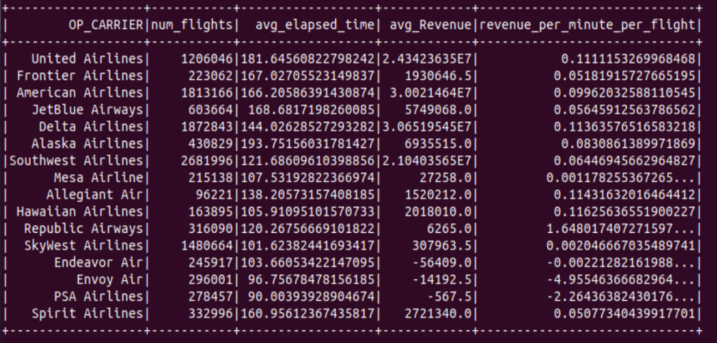
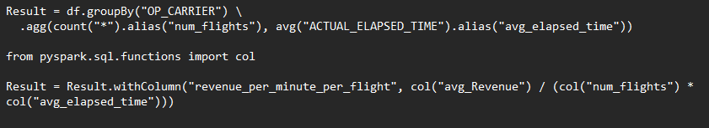
Business question #2: Which Airline on average has the most arrival and departure delays, what are the potential solutions, and subsequent cost savings?
Table 6: Table Displays number of flights, average time elapsed per flight, average Revenue (in thousands), and average Revenue per minute per flight in (in thousands). Yearly expenses are also available and are not shown in this chart.

Slide 13
Business question #2: Which Airline on average has the most arrival and departure delays, what are the potential solutions, and subsequent cost savings?
Question Findings
Table 6: Table Displays number of flights, average time elapsed per flight, average Revenue (in thousands), and average Revenue per minute per flight in (in thousands). Yearly expenses are also available and are not shown in this chart.
JetBlue was identified as being the worst performing Airline.
26% of all JetBlue’s 603,664 flights were delayed greater than 15 minutes (150,916)
JetBlue’s Average Revenue was $ 5.74 Billion dollars and average expenses were $6.51 Billion
Based on average elapsed time, JetBlue expenses were calculated at $63.35/min with an average arrival delay of 46.44 minutes per delayed flight
we can estimate a cost of $443 million in additional Flights Ops per year due to delays.

Slide 14
Business question #2: Which Airline on average has the most arrival and departure delays, what are the potential solutions, and subsequent cost savings?
Question Solutions
Table 6: Table Displays number of flights, average time elapsed per flight, average Revenue (in thousands), and average Revenue per minute per flight in (in thousands). Yearly expenses are also available and are not shown in this chart.
To cut down on potential delays JetBlue should look to:
Find ways to streamline operations, such as reducing boarding times and optimizing flight paths, will help airlines stay on schedule and reduce delays.
Improve maintenance procedures: Ensuring that all aircraft are well-maintained and ready to fly on schedule can help reduce delays caused by maintenance issue
Collaborate with other airlines: Sharing resources, such as aircraft and crew, can help airlines better manage unexpected delays and reduce the overall impact on passengers.

Slide 15
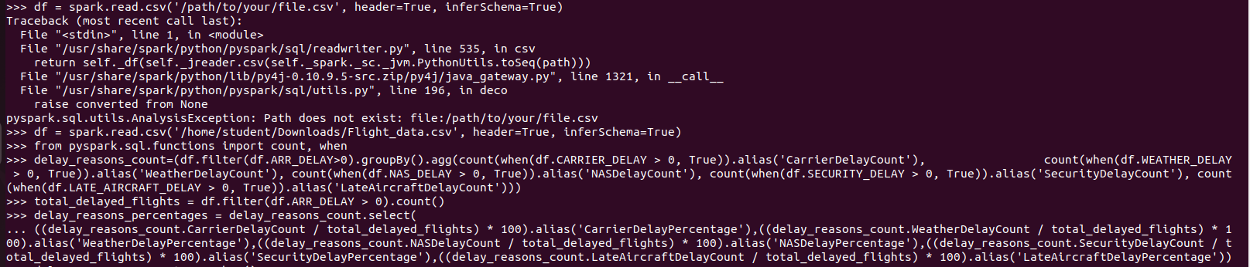
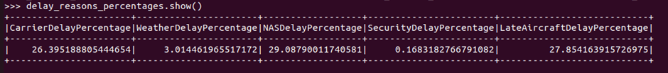
Business question #3: Which factor amongst security clearance, carrier delay, weather disturbance, late aircraft and NAS has been responsible for causing the greatest number of departure delays?

Slide 16
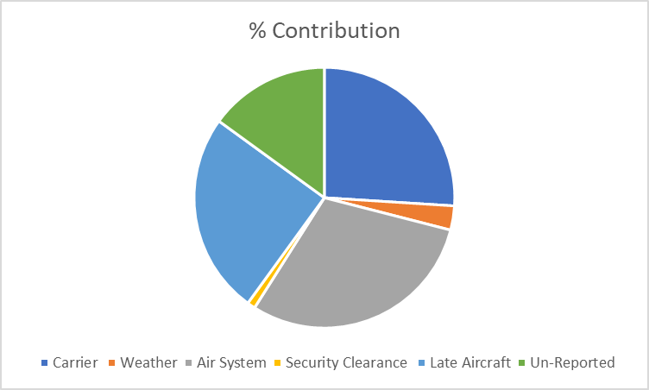
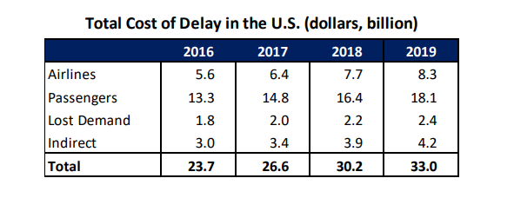
Business question #3: Which factor amongst security clearance, carrier delay, weather disturbance, late aircraft and NAS has been responsible for causing the greatest number of departure delays?
Question Findings
Flight delays not only cause inconvenience to passengers, but also cost the carriers billions of dollars.
In addition to the costs suffered by passengers, airlines suffer from extra crew costs, costs associated with accommodating disrupted passengers, and aircraft re-positioning, as airline fleet and crew schedules are largely based on the scheduled times.
National Airspace System (NAS) Delay, Carrier Delay, and Late Aircraft Delay each made up at least 25% of all delays
​Air System Delay made up the majority of delays with 29%. Reducing even 5 percentage points, could have saved airlines up to 700 million dollars.
Figures as reported by FAA

Slide 17

Business question #3: Which factor amongst security clearance, carrier delay, weather disturbance, late aircraft and NAS has been responsible for causing the greatest number of departure delays?
Question Solutions
NAS could benefit ​from upgrading their air systems with newer technology that is more reliable and efficient. This can help to prevent breakdowns and reduce the risk of delays.
Airports should have contingency plans in place for dealing with air system issues, such as having backup systems or alternate aircraft available if needed.
Airlines can provide training and education to their staff on how to identify and troubleshoot air system issues. This can help to prevent delays caused by small issues that can be easily fixed by staff members.
A technology developed by the Federal Aviation Administration (FAA), is the embodiment of efficiency, representing the modernization of the U.S. air traffic system, from radar-based surveillance to highly precise satellite monitoring of all the aircraft in our skies

Slide 18
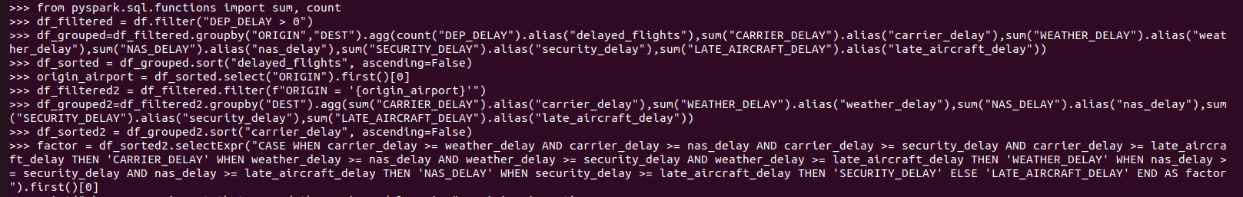
Business question #4: Between which Airport had the greatest number of delays and what delay factor contributed the most?

Slide 19
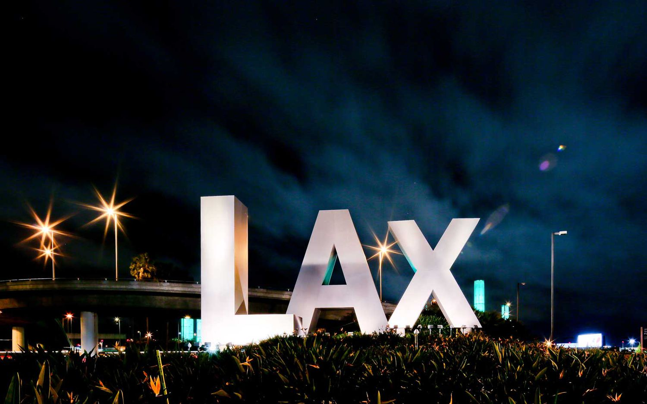
Business question #4: Between which Airport had the greatest number of delays and what delay factor contributed the most?
Question Findings
LAX airport operates at or near capacity during peak hours, which results in Late aircraft delays.
LAX has several runways that intersect, which can create operational challenges for airlines and air traffic control. This can lead to longer taxi times and delays in take-off and landing.
LAX is known for unpredictable weather conditions, particularly during the summer months. ​
LAX stands for Los Angeles International Airport, which is the primary international airport serving the Greater Los Angeles area in Southern California, United States.

Slide 20
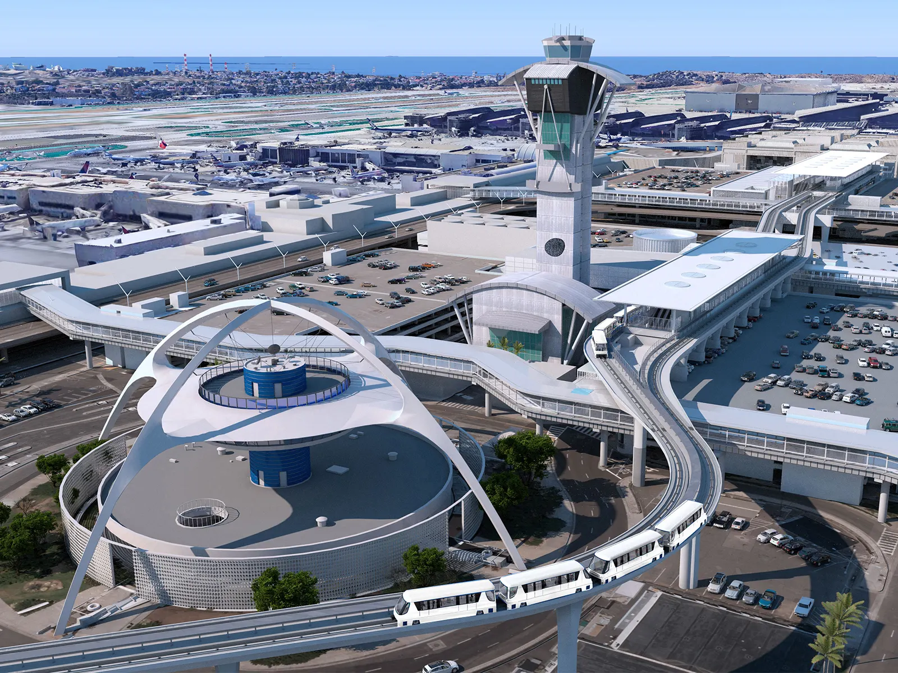
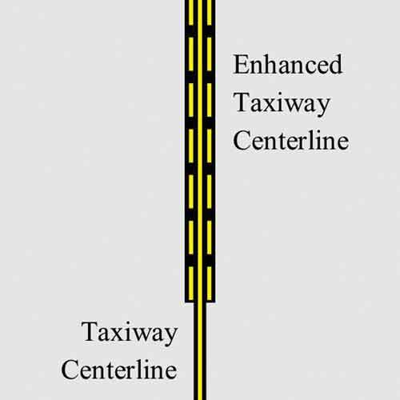
Business question #4: Between which Airport had the greatest number of delays and what delay factor contributed the most?
Question Solutions
Enhanced Infrastructure at LAX
Improve communication with airlines: LAX can work with airlines to better understand their schedules and needs and adjust its operations accordingly to minimize delays.
Expand airport capacity by expanding terminal facilities and adding more gates, LAX can accommodate more flights and reduce congestion on the runways, helping to reduce aircraft delays.
Improve runway and taxiway maintenance: Regular inspections and repairs of runways and taxiways can reduce the likelihood of aircraft delays caused by maintenance issues.
Taxiway Maintenance

Slide 21
THANKYOU!

